Slide 1
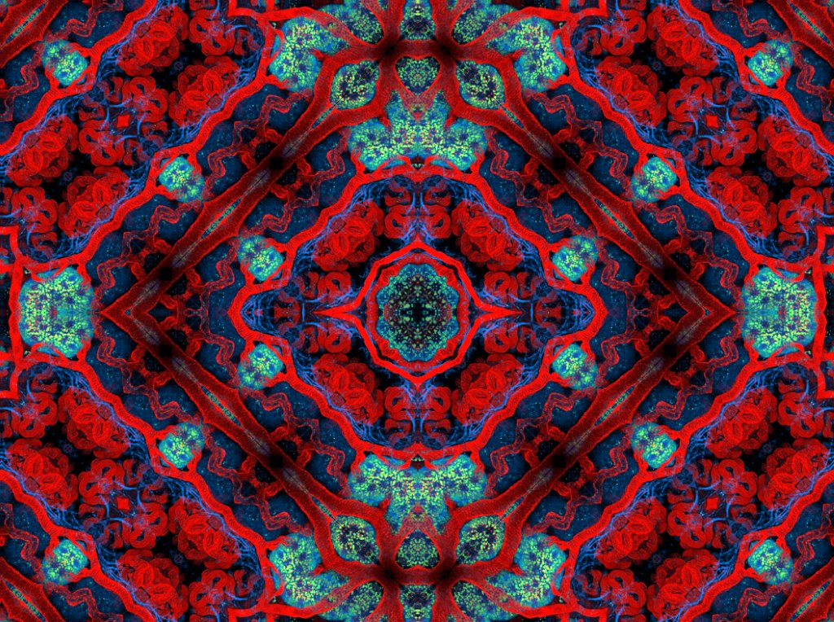
RUBEN SANDOVAL
kidney kaleidoscope

Slide 2
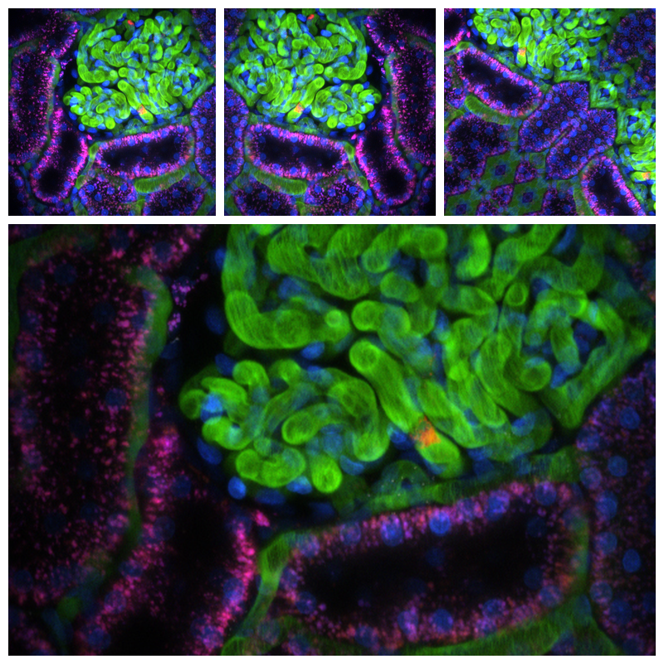
Unpacking RUBEN Sandoval
Group Talk
What can scientists learn from looking at the kinds of pictures Dr. Sandoval makes? We can see cellular structures and look for abnormalities in tissues. Why might this be important?
How would you describe Dr. Sandoval’s art? Do you like it? Why or why not? You might discuss symmetry and repetition, or color theory.
Why are Dr. Sandoval’s pictures so colorful? Do all of his colors “go together”? Do some of them “clash”? Which piece has your favorite color combination? Sandoval’s art is so colorful because he uses specialized dyes, which we will talk about later in this lesson!
What is a tessellation? Where are some other places we see tessellations? In nature, in other artists’ works, in architecture and history, etc.

Slide 3
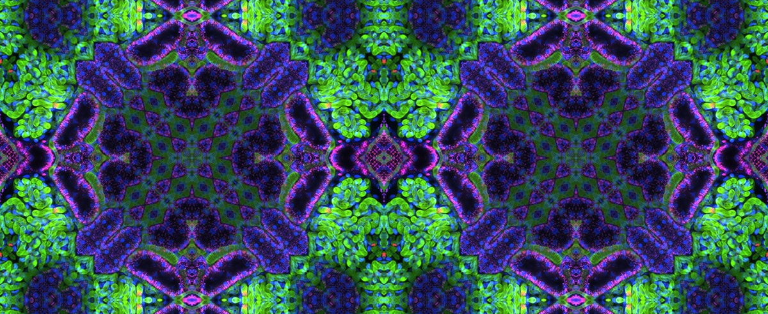
Unpacking Ruben Sandoval
Group Talk
Dr. Sandoval’s work is a combination of art and science: his scientific research is the basis of the artwork he creates. Are these two creative endeavors opposites, or do they have some things in common? What other school subjects or ways of thinking do we sometimes use when we make art? Is this a good thing?
What is it about tessellations that make art like Dr. Sandoval’s so cool? Is symmetry always better than asymmetry?

Slide 4
lets talk Microscopy
If we are going to understand how artists and scientists such as Ruben Sandoval use microscopy, it would be best to know some basic background info about microscopy and imaging. Here are some engaging questions to begin with:
Group Talk
What experience do any of you have with microscopes? What have you seen on TV or in other classes?
Have you ever used a microscope?
What do we look at with microscopes? Only small things? Only living things?
Why might we want to take pictures of what we see through a microscope?
Scanning Electron microgram (color enhanced) of pollen grains, from Wikipedia.org

Slide 5
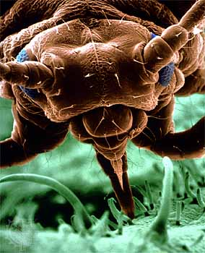
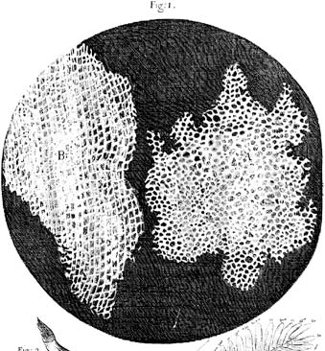
A bit of Microscopy history
So where did the microscope come from?
The compound light microscope (the most common and simplest form of microscopes) was invented in the early 1600s in the Netherlands. Although we don’t know who invented it first, within a few decades many scientists had built their own and were discovering the microscopic world for the first time. Before microscopes, we couldn’t see anything smaller than a hair—think about that!
The most famous of these microscope-inventing scientists is Anton van Leeuwenhoek, who was the first to see blood cells and spermatozoa, and by 1676 had discovered the existence of micro-organisms. Because he was the first to make and use a practical microscope, he is considered the father of microbiology. Meanwhile Robert Hook was using microscopes to look at skin tissues and plants, and was the first to coin the term “cell,” to describe the building blocks of all living organisms. With the help of microscopes, scientists could now observe—and record!– what cannot be seen by the naked eye. They always carefully drew what they saw so that they could share their discoveries with the scientific community and other curious individuals.
Although light microscopes allowed us to see much more than the human eye is capable of seeing by itself, they are limited by how much light can shine through the specimen and by how strong the lenses of the microscope are. We have solved this problem by combining microscopes with computers, so that anything that can be seen through the microscope can also be saved in the computer. Using computer technology, we can blast specimens with lasers to see through them easier, or use special dyes and different UV lights to see specific substances, infections, or parts of the cell. This is how Dr. Sandoval creates his colorful artwork!
Today, there are many types of microscopes scientists use, besides the light microscope. We have electron scanning microscopes to see things as tiny as the inside of a virus (that’s over 1 million times magnified!). That doesn’t mean, however, that the good ole’ fashioned compound light microscope has gone out of style. Scientists, doctors, students, and artists all over the world still use microscopes every day.
Scanning electron color enhanced micrograph (that’s what you call a picture of what you see in the microscope) of an aphid at 50x magnification
Drawings of cork cells, observed through the microscope by Robert Hooke.
microscope. 2016. Encyclopædia Britannica Online. Retrieved 20 March, 2016, fromhttp://www.britannica.com/technology/microscope

Slide 6
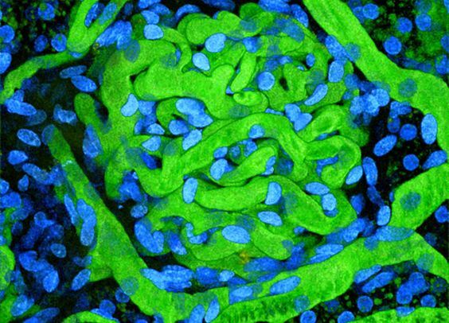
Group Talk
How did microscopes change how we see and think about the world? They gave us an understanding of cells, germs, DNA, single-celled organisms, and all the countless things we couldn’t see before. They helped us understand that the world is bigger (and smaller) than it appears!
Why did scientists like Robert Hooke and Ruben Sandoval depict what they observed? Why did it matter if they shared their discoveries?
Can these renderings be considered art? Why or why not?
How do artists and scientists differ? How are they alike? Artists and scientists usually use very different mediums, but they both share a common goal: observe, explain, expound upon, imitate or simply just share the world they see.

Slide 7
hands-on with Microscopy
Ready to try your hand at Dr. Sandoval’s type of art?
Let’s give it a shot!
https://www.youtube.com/watch?v=UOHxNbxm-m4
Gross Science has a great video that will walk you through how to make your own microscope, if you don’t have one lying around. While Anna recommends you use puddle water, you can use just about anything! Pluck some hair. Pick a daisy. Dip into your fish tank. Scape something suspicious off a damp tree trunk. The possibilities are endless… it’s your art! Just whatever you do, don’t forget to record your observations! (An observation record is provided on the next slide)
Group Talk
How would you describe what you see? Is it structured? Chaotic? Repetitive? Unique? Is it moving? Is it alive, or dead? Is it beautiful, ugly, or just in between?
Why would someone want to look at what you’re looking at?
Look at your drawings. Would you consider this art? If you saw these pictures hanging in a gallery, what sort of message or feeling would you think the artist was conveying?

Slide 8
Specimen:__________________________________
Notes:
Specimen:__________________________________
Notes:
Specimen:__________________________________
Notes:

Slide 9
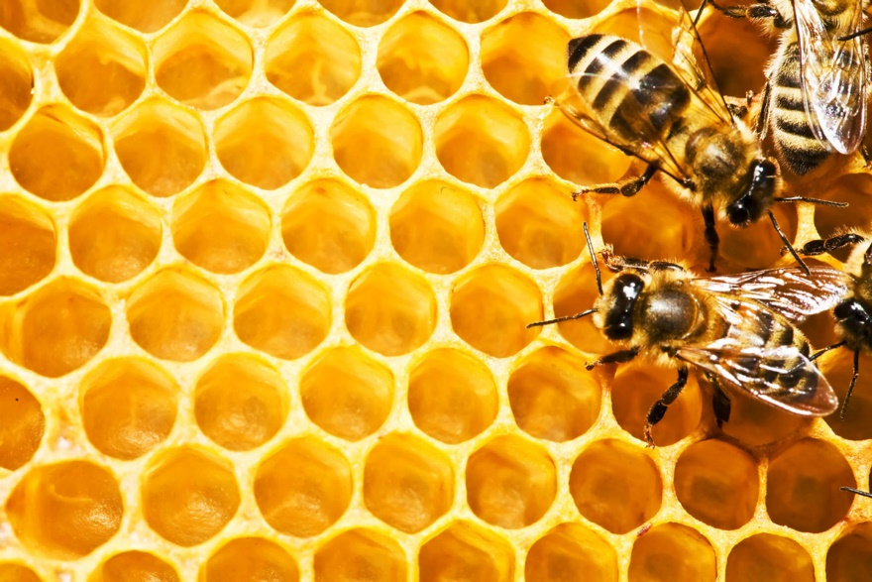
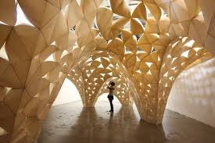
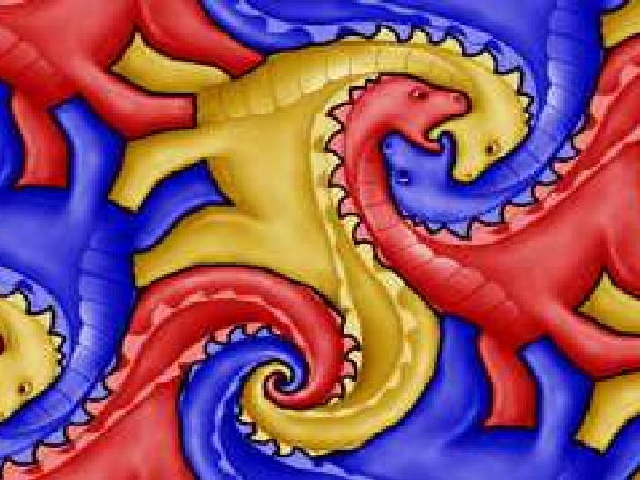
A closer look at Tessellations…
http://www.freegreatpicture.net/animal-collection/bees-and-honeycomb-21462
https://www.pinterest.com/pin/153192824802533813/
https://www.123rf.com/stock-photo/professor_cartoon.html
http://www.clipartpanda.com/categories/science-clip-art-pictures-printable
http://www.slideshare.net/ksumatarted/tessellations-9394890

Slide 10
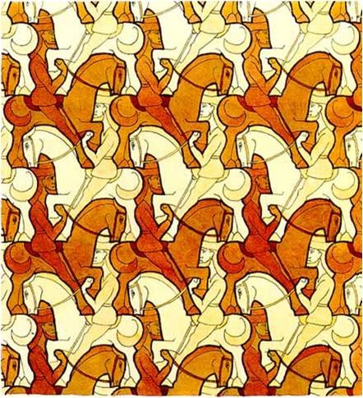
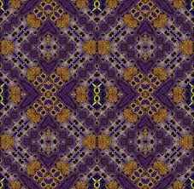
What are tessellations?
Tessellation is another word for tiling. A tessellation is created when you fit individual tiles together to fill a flat space like a floor, wall or ceiling without gaps or overlaps.
Although we do not know when tiles were first invented, the Tile Association notes that pieces of tiles dating from between 12,000 and 18,000 years ago have been found in sites located along the Nile River.
Sandoval and Tessellations
Notice how the patterns in Dr. Sandoval’s artwork repeat over and over? How the same image gets repeated throughout the piece and can be continued forever? That makes it a tessellation!
Group Talk
http://mmsart.blogspot.com/2011/11/teasing-tessellations.html
http://mmsart.blogspot.com/2011/11/teasing-tessellations.html
Why do you think Ruben tessellated his pictures? Do you think they look better before or after he tessellated it?
Symmetry plays a major part in tessellations. Do we see more symmetry or asymmetry in our lives?
http://tdbcons.com/art-by-ruben-m-sandoval
http://classroom.synonym.com/invented-tessellations-15952.html

Slide 11
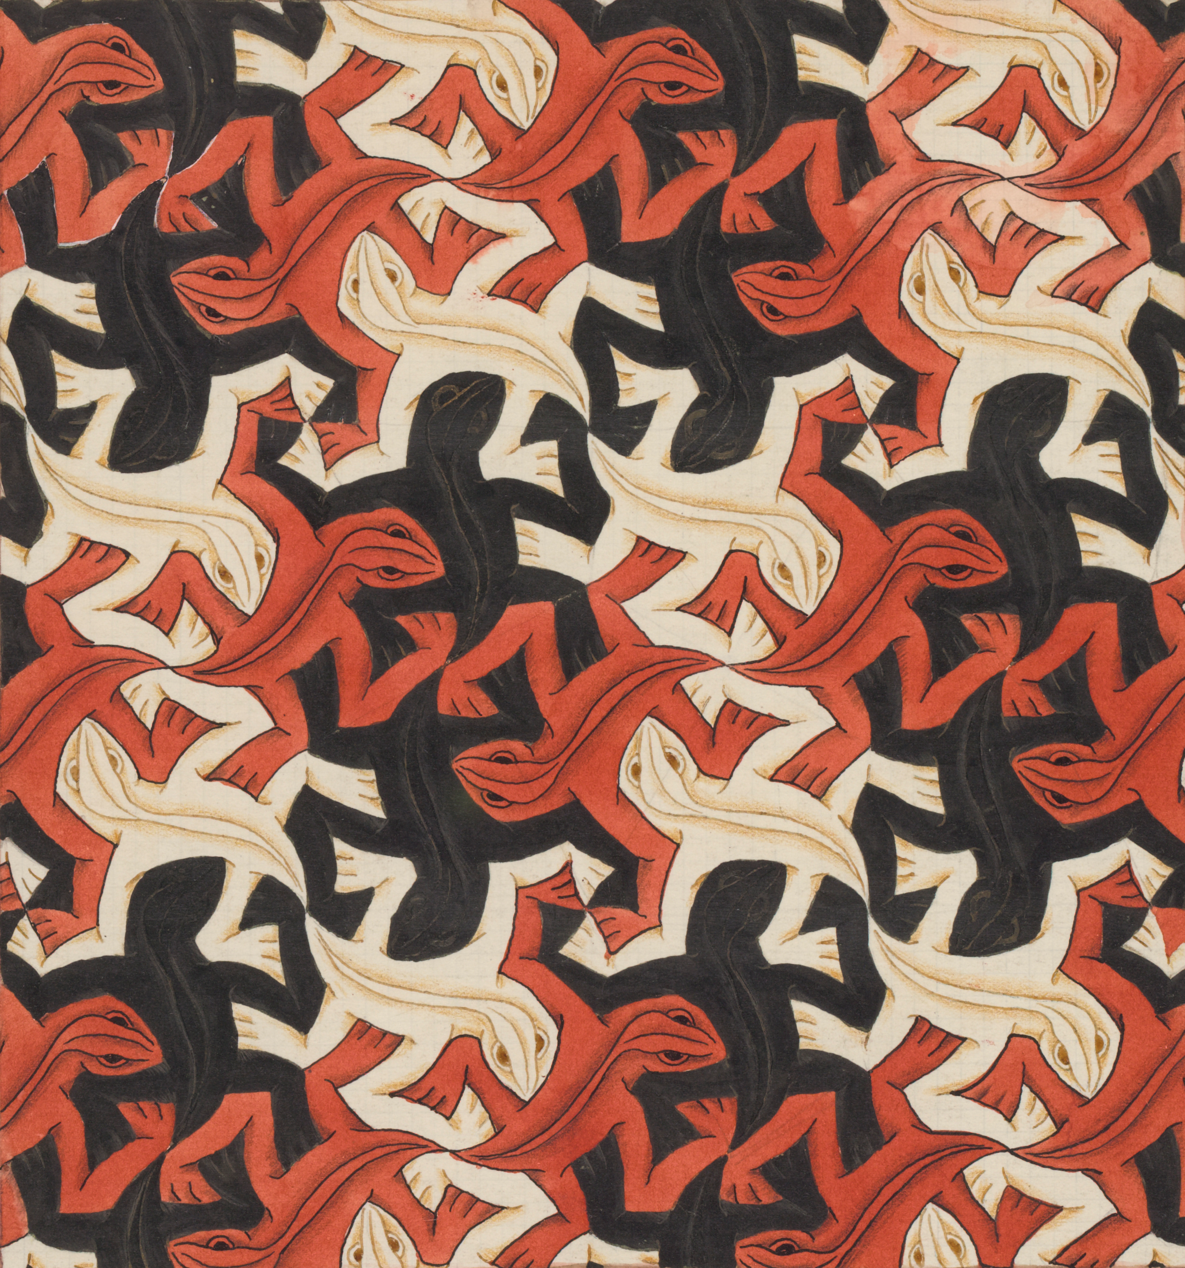
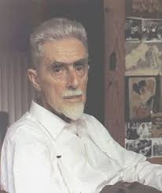
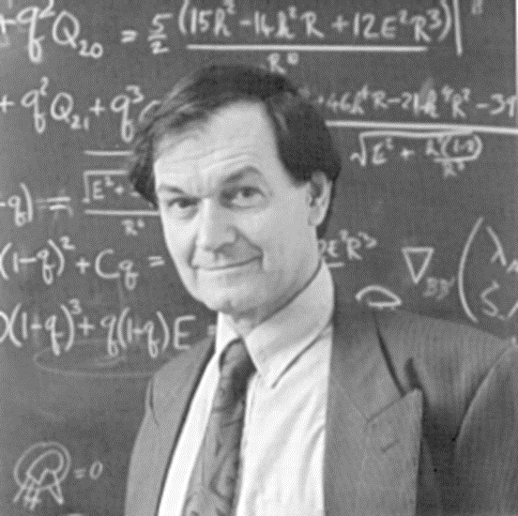
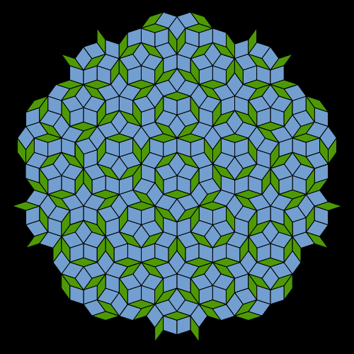
Art or Math?
“Lizards” – M. C. Escher
Maurits Cornelis Escher (M. C. Escher)
M. C. Escher was an amazing artist who was influential in incorporating tessellations into art. In his early years, Escher sketched landscapes and nature. He also sketched insects such as ants, bees, and grasshoppers, which appeared frequently in his later work.
Although Escher did not have mathematical training, his understanding of mathematics was largely visual and intuitive. Several of the works he drew were built around impossible objects.
http://www.goodreads.com/book/show/558558.The_Magic_of_M_C_Escher
Check out http://www.mcescher.com/about/biography/ to learn more about M. C. Escher!
Sir Roger Penrose
https://www.pinterest.com/pin/38280665557450532/
“Penrose Tiling”
Sir Roger Penrose was born August 8, 1931, Colchester, Essex, England. He was even knighted for his services to science in 1994!
Penrose was very involved in mathematics and grand calculations about matter in outer space. He calculated many of the basic features of black holes and in 1969, with Stephen Hawking, Penrose proved that all matter within a black hole collapses.
http://www.worldofescher.com/misc/penrose.html
There is even a specific tessellation named after him called the Penrose Tiling!
A Penrose Tiling must be constructed to have both reflection symmetry and fivefold rotational symmetry.
Go to http://www.britannica.com/biography/Roger-Penrose to learn more about Sir Roger Penrose!
https://en.wikipedia.org/wiki/Penrose_tiling

Slide 12
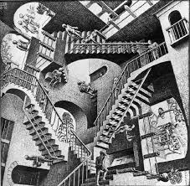
“Only those who attempt the absurd
will achieve the impossible. I think
it’s
in my basement...
let me go upstairs and
check.”
- M. C. Escher
https://en.wikipedia.org/wiki/M._C._Escher

Slide 13
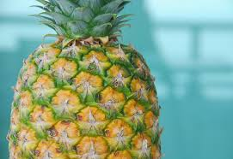
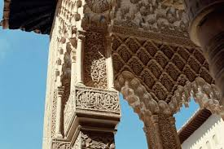
Tessellations in the world around us
Tessellations are all around you!
So now we know that tessellations can be seen in mathematics and art. Can you think of any other places?
Believe it or not, you can find tessellations all around the world!
Tessellations exist everywhere in nature. Humans since the dawn of our species have been drawn to them and reproduced them not only in art, but also in architecture, quilts, tiling, toys, and many other places.
Take a look around you. What tessellations do you see?
http://geoinnature.blogspot.com/2012/04/tessellation-examples.html
Group Talk
Where do you see tessellations in your life?
Why do tessellations matter? How can they be useful and helpful?
http://people.opposingviews.com/tessellations-islamic-art-2800.html
http://www2.gvsu.edu/oxfordj/angie.html

Slide 14
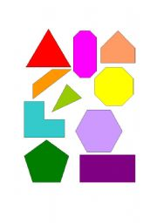
Activity: Introduction to tessellations
Creating Tessellations
Objectives - NCTM Grade 6-8 Standards: Geometry, Reasoning and Proof, Communication and Connections
1. To manipulate triangles, squares, hexagons, trapezoids, and rhombuses to see how they might combine to form patterns in the plane.
2. To consider which of these patterns are tessellations and which are not using the definition that a tessellation is a tiling with shapes that cover the plane without gaps or overlaps.
3. To consider which of these patterns are regular tessellations and which are not using the definition that a regular tessellation is a tiling with shapes that cover the plane in a regularly repeating pattern without gaps or overlaps.
Materials
Activity pattern blocks or paper cutouts of shapes such as squares, circles, hexagons, pentagons, triangles, diamonds, trapezoids, rhombuses, and others or your choice.
jjjj
http://www.eslprintables.com/printable.asp?id=52668
Procedures
1. Instruct the students to make patterns with the blocks, making certain that they leave no gaps or spaces.
2. After each student or group of students has a pattern, have all of the students rotate around the room to view each others' products.
3. Discuss the patterns.
4. Discuss the relationships between the blocks.
Questions
Which shapes fit together easily?
Which shapes don't seem to fit with the others?
Which patterns could be repeated over and over again in the plane?
What shapes fit together making a pattern using only one type of block?
What shapes fit together making a pattern using two blocks that are different?
What shapes fit together making a pattern using three blocks that are different?
http://mathforum.org/sum95/suzanne/active.html

Slide 15
Another Tessellation activity
Sometimes it is hard to see how we can make tessellations with shapes other than regular polygons like squares, circles, triangles, and others.
This activity provides instructions for how to create tessellations from any shape!
Here’s a quick look at what the activity asks students to do:
Take a look at this link for the full activity!
http://www.exploratorium.edu/geometryplayground/Activities/GP_Activities_6-8/ExploringTessellations_%206-8_v4.pdf

Slide 16
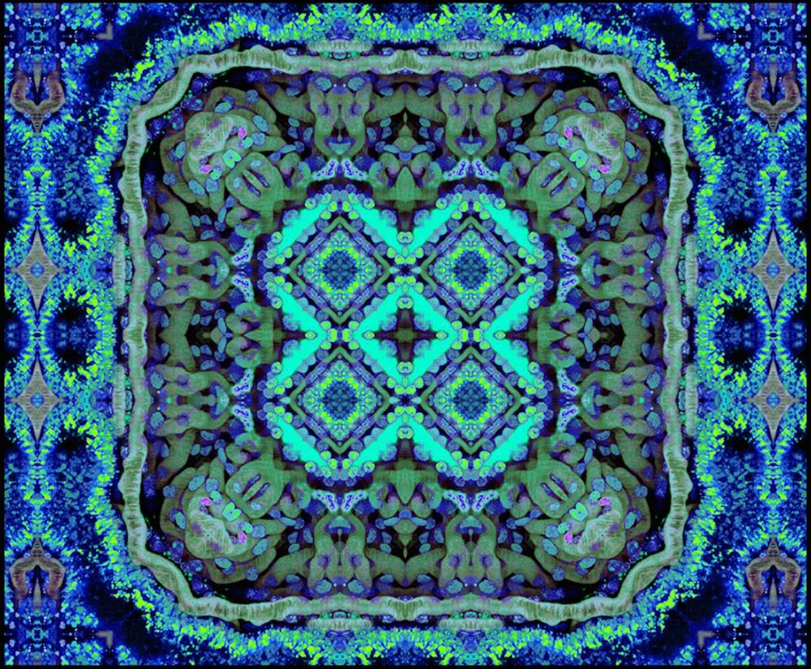
“Tessellated Kidney I” Ruben Sandoval

Slide 17
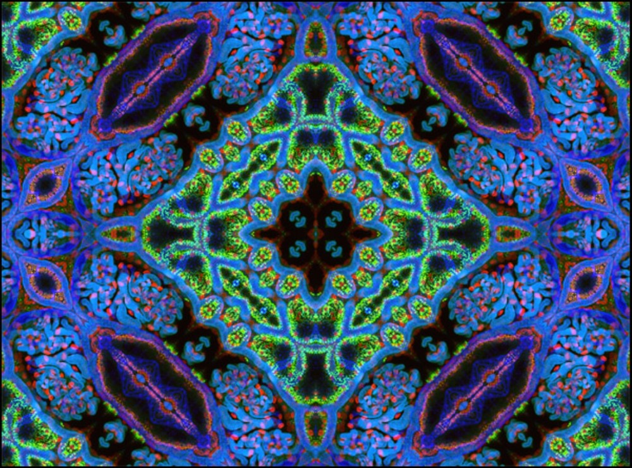
“Tessellated Kidney V” Ruben Sandoval

Slide 18
Assessment
Assessment for Project
Failed to Almost Great Went above and
Complete Finished Job! Beyond expectations
EFFORT LEVEL | NO EFFORT | LITTLE EFFORT | GREAT EFFORT! | AMAZING EFFORT!
Followed instructions
Appropriately used H20 color & techniques such as wet on wet
Used perspective within the landscape in an imaginative manner
Showed an understanding of Vining’s use of bold line
Originality of work
Completed in a timely manner
360. Student thought through & utilized entire image
Craftsmanship/Effort
Attitude/Showed respect for others and their work
POINT VALUE | 0 | 1 | 2 | 3
TOTALS
As you probably already know, assessment within the arts is incredibly messy. As an educator, my goal has always been to focus primarily on effort, and very clear, measurable skills. Feel free to adjust this rubric to fit your goals as well as those of your students.
Total Number of points = ___________
Extra sketches (10pts. Possible) = _________
Total Points = _________
Grading Scale-
A 25 - 30 B 20 - 25 C 15 - 20 D 10 - 15 F 0 – 10

Slide 19
educational standards
Within every episode we strive to meet every content standard within the National Core Arts Standards. Please be sure to include and reference these standards when preparing and documenting your lessons. For additional, and more in-depth information, you can reference this site.
Associated Anchor Standards
Creating
#VA:Cr1.1
Anchor Standard: Generate and conceptualize artistic ideas and work.
Enduring Understanding: Creativity and innovative thinking are essential life skills that can be developed.
Essential Question: What conditions, attitudes, and behaviors support creativity and innovative thinking? What factors prevent or encourage people to take creative risks? How does collaboration expand the creative process?
#VA:Cr1.2
Anchor Standard: Generate and conceptualize artistic ideas and work.
Enduring Understanding: Artists and designers shape artistic investigations, following or breaking with traditions in pursuit of creative art-making goals.
Essential Question: How does knowing the contexts histories, & traditions of art forms help us create works of art & design? Why do artists follow or break from established traditions? How do artists determine what resources are needed to formulate artistic investigations.
#VA:Cr2.1
Anchor Standard: Organize and develop artistic ideas and work.
Enduring Understanding: Artists and designers experiment with forms, structures, materials, concepts, media, and art-making approaches.
Essential Question: How do artists work? How do artists and designers determine whether a particular direction in their work is effective? How do artists and designers learn from trial and error?

Slide 20
educational standards
Creating
#VA:Cr2.3
Anchor Standard: Organize and develop artistic ideas and work.
Enduring Understanding: People create and interact with objects, places, and design that define, shape, enhance, and empower their lives.
Essential Question: How do objects, places, and design shape lives and communities? How do artists and designers determine goals for designing or redesigning objects, places, or systems? How do artists and designers create works of art or design that effectively communicate
#VA:Cr3.1
Anchor Standard: Refine and complete artistic work.
Enduring Understanding: Artist and designers develop excellence through practice and constructive critique, reflecting on, revising, and refining work over time.
Essential Question: What role does persistence play in revising, refining, and developing work? How do artists grow and become accomplished in art forms? How does collaboratively reflecting on a work help us experience it more completely?

Slide 21
educational standards
Responding
#VA:Re7.1
Anchor Standard: Perceive and analyze artistic work.
Enduring Understanding: Individual aesthetic and empathetic awareness developed through engagement with art can lead to understanding and appreciation of self, others, the natural world, and constructed environments.
Essential Question: How do life experiences influence the way you relate to art? How does learning about art impact how we perceive the world? What can we learn from our responses to art?
#VA:Re7.2
Anchor Standard: Perceive and analyze artistic work.
Enduring Understanding: Visual imagery influences understanding of and responses to the world.
Essential Question: What is an image? Where and how do we encounter images in our world? How do images influence our views of the world?
#VA:Re8.1
Anchor Standard: Interpret intent and meaning in artistic work.
Enduring Understanding: People gain insights into meanings of artworks by engaging in the process of art criticism.
Essential Question: What is the value of engaging in the process of art criticism? How can the viewer "read" a work of art as text? How does knowing and using visual art vocabularies help us understand and interpret works of art?
#VA:Re7.2
Anchor Standard: Perceive and analyze artistic work.
Enduring Understanding: Visual imagery influences understanding of and responses to the world.
Essential Question: What is an image? Where and how do we encounter images in our world? How do images influence our views of the world?

Slide 22
educational standards
Connecting
#VA:Cn11.1
Anchor Standard: Relate artistic ideas and works with societal, cultural, and historical context to deepen understanding.
Enduring Understanding: People develop ideas and understandings of society, culture, and history through their interactions with and analysis of art.
Essential Question: How does art help us understand the lives of people of different times, places, and cultures? How is art used to impact the views of a society? How does art preserve aspects of life?
#VA:Re8.1
Anchor Standard: Interpret intent and meaning in artistic work.
Enduring Understanding: People gain insights into meanings of artworks by engaging in the process of art criticism.
Essential Question: What is the value of engaging in the process of art criticism? How can the viewer "read" a work of art as text? How does knowing and using visual art vocabularies help us understand and interpret works of art?
copyright 2016 Artrageous with Nate, LLC.

Slide 23
Science and Math standards
Common Core Math:
7G2. Draw (freehand, with ruler and protractor, and with technology) geometric shapes with given conditions. Focus on constructing triangles from three measures of angles or sides, noticing when the conditions determine a unique triangle, more than one triangle, or no triangle
8G1. Understand congruence and similarity using physical models, transparencies, or geometry software. Verify experimentally the properties of rotations, reflections, and translations: a. Lines are taken to lines, and line segments to line segments of the same length. b. Angles are taken to angles of the same measure. c. Parallel lines are taken to parallel lines.
NSTA Science Standards
MS-LS1-1 Conduct an investigation to provide evidence that living things are made of cells; either one cell or many different numbers and types of cells.

