Slide 1
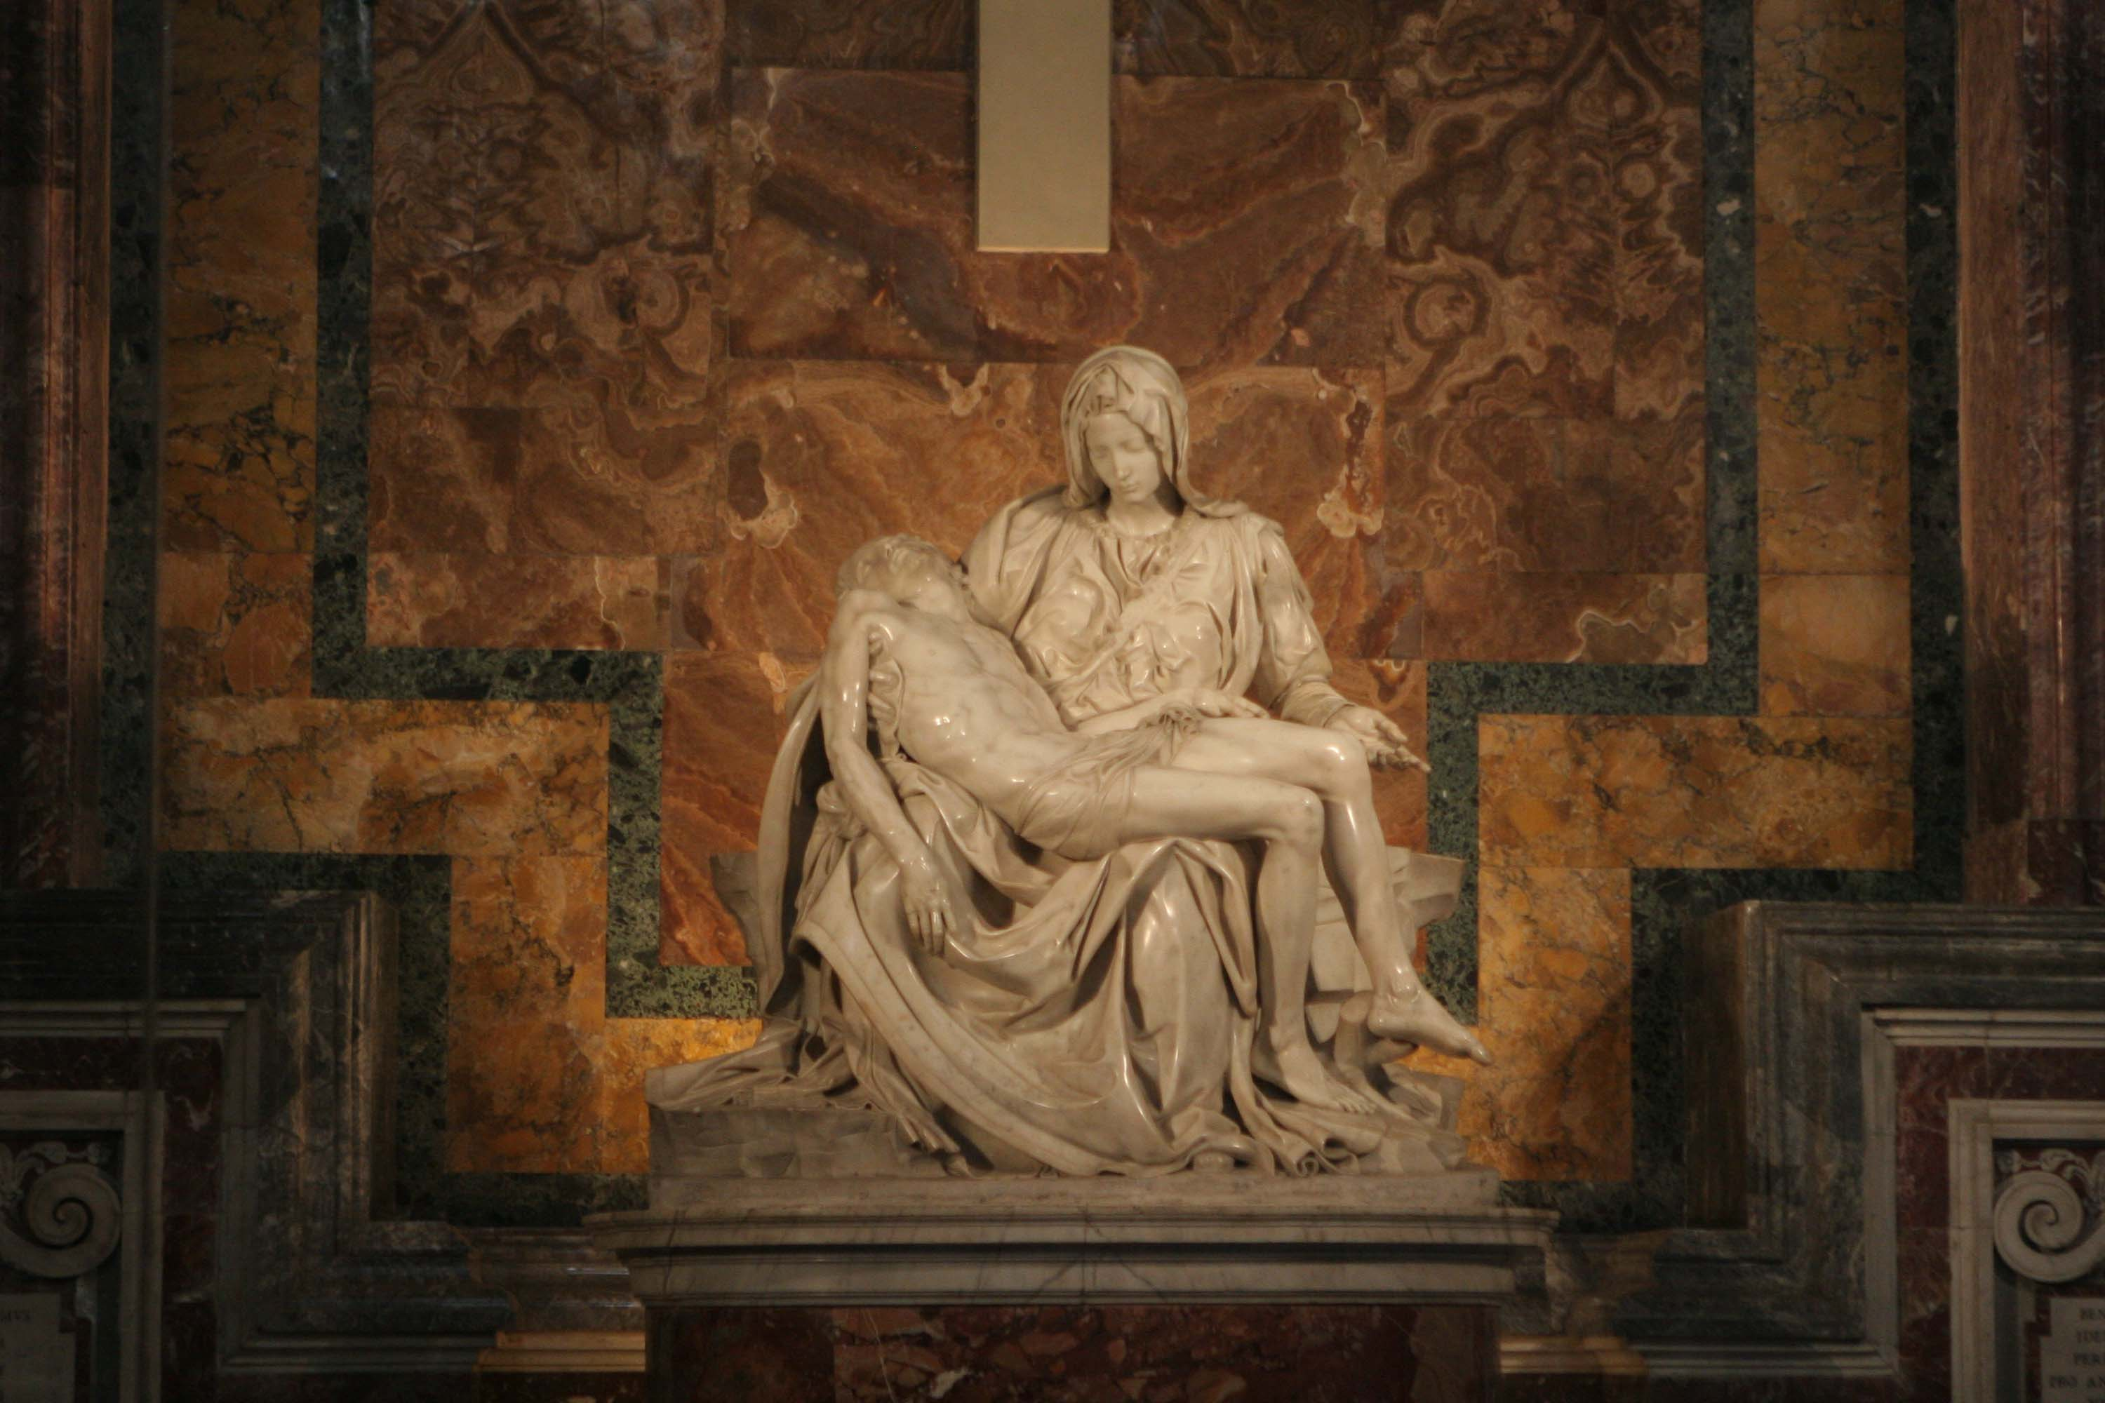
  Justin Vining
Michelangelo
The Wonder Years
Notes:
La Pieta - http://stpetersbasilica.info/Altars/Pieta/Pieta-GMR_6315.jpg

Slide 2
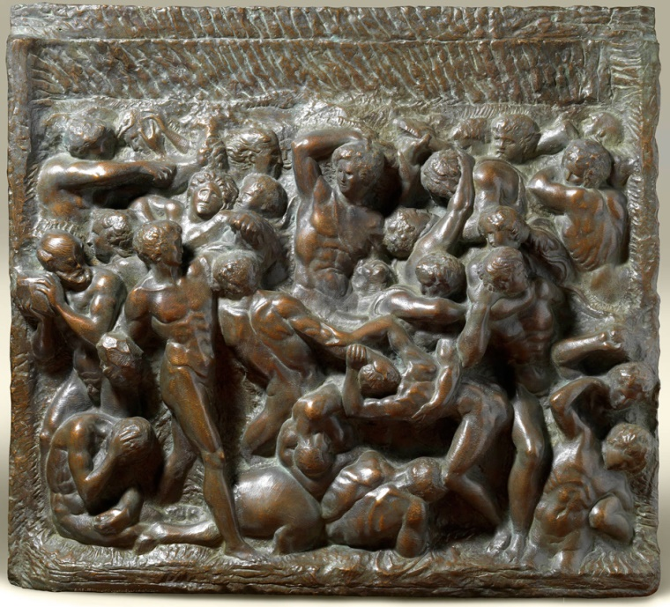
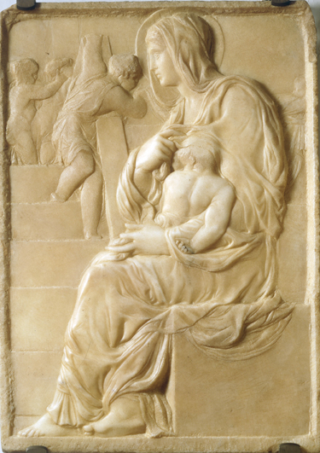
Unpacking michelangelo
Group Talk
How did Michelangelo’s experiences growing up impact his life as an artist? His interactions with his family show conflict. Could this have contributed to his character as an artist?
Why were artists not regarded as being of a noble profession during Michelangelo’s lifetime? Many rulers gained their status through acquiring wealth. What challenges made being a wealthy artist a difficult task?
What other famous artists were alive when Michelangelo was? How might they have influenced Michelangelo’s work?
How are Michelangelo’s sculptures impressive, even by today’s standards? Consider the size of David as well as the ripple effect on La Pieta, what differences are there today in creating these techniques?
http://www.michelangeloexperience.com/wp-content/uploads/2010/09/battle-of-centaurs-michelangelo-sculpture-sm.jpg
https://upload.wikimedia.org/wikipedia/commons/b/b2/Buonarotti-scala.jpg
Notes:
Battle of the Centaurs - http://www.michelangeloexperience.com/wp-content/uploads/2010/09/battle-of-centaurs-michelangelo-sculpture-sm.jpg
Madonna of the Stairs - https://upload.wikimedia.org/wikipedia/commons/b/b2/Buonarotti-scala.jpg

Slide 3
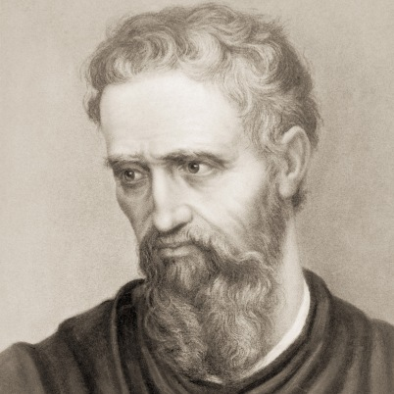
Unpacking Michelangelo
Group Talk
Much of Michelangelo’s works are religious in nature, including his most famous early works David and La Pieta. Why is this the case? What kinds of works are prominent today and why?
How important is it to have experience creating art versus having talent at it? Michelangelo was creating master sculptures while in his early 20’s, does this mean that all great artists must show talent at a young age? Explain
http://www.michelangelo.org/images/michelangelo.jpg
Notes:
Michelangelo Portrait - http://www.michelangelo.org/images/michelangelo.jpg

Slide 4
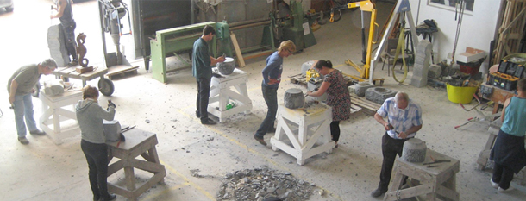
  lets talk Sculpting
If we are going to understand how artists such as Michelangelo created beautiful stone sculptures, it would be best to know some basic background on stone carving. Here are some engaging questions to begin with:
Group Talk
What experience do any of you have with carving stone if any?
Have you ever used a set of chisels?
What are some benefits of modern technology that aid in creating?
When did stone carving originate? What kinds of civilizations carved stone for art?
http://www.craftinireland.com/content/events/Stone_Carving_Workshop.jpg
Notes:
Carving workshop - http://www.craftinireland.com/content/events/Stone_Carving_Workshop.jpg

Slide 5
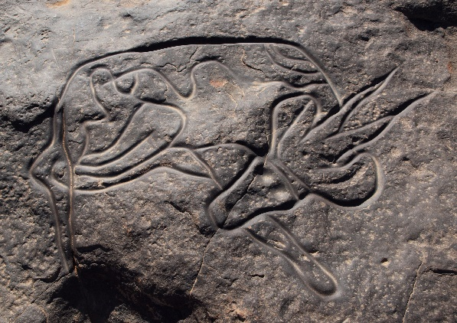
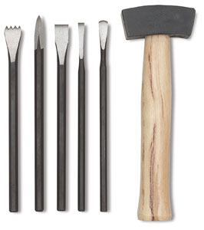
A bit of Sculpting History
So where did sculpting come from? Here is a short explanation of the history and tools involved.
Sculpture may be the oldest of the arts. People carved before they painted or designed dwellings. The earliest drawings were probably carved on rock or incised (scratched) in earth. Therefore, these drawings were as much forerunners of relief sculpture as of painting. From recent primitive sculpture and from the few surviving prehistoric pieces, we can judge that prehistoric sculpture was never made to be beautiful. It was always made to be used in rituals. In their constant fight for survival, early people made sculpture to provide spiritual support.
Figures of men, women, and animals and combinations of all these served to honor the strange and sometimes frightening forces of nature, which were worshiped as evil or good spirits. Sculpture in the form of masks was worn by priests or medicine men in dances designed to drive away evil spirits or beg favors from good ones.
The earliest civilizations of Egypt, Mesopotamia, the Indus Valley, and China gradually developed forms of writing about 3000 B.C. The people of these civilizations, like their prehistoric ancestors, also expressed deeply felt beliefs in sculpture.
The stone used in sculptures comes in many different varieties, giving artists plenty of choice in respect of color, quality and hardness. The hardest and most weatherproof stone is igneous rock. Sedimentary stones may also be used, although they contain noticeable strata. Metamorphic stones, formed by changes to igneous and sedimentary rock caused by extreme temperature or pressure, are very popular with sculptors: the best example being the different types of marble.
During the Renaissance period the main tools for a sculptors would include: a set of chisels including flat, pointed, round-ended, toothed, and splitting chisels, as well as a mallet used to strike the chisel. The sculptor would use several different hammers to strike the edge-tools like the chisels and also the stone itself.
In addition to these traditional tools, 20th-century sculptors had access to pneumatic hammers, as well as other power tools like a diamond-bladed angle-grinder, and numerous hand drills. Today, in keeping with the principles of postmodernist art, stone carvers may use even more sophisticated equipment, such as oxy-acetylene torches, lasers and jet heat torches.
https://upload.wikimedia.org/wikipedia/commons/6/61/Sleeping_Antelope_Tin_Taghirt.jpg
http://cdn.dick-blick.com/items/330/26/33026-0000-2ww-m.jpg
http://www.scholastic.com/browse/article.jsp?id=3753866
http://www.visual-arts-cork.com/sculpture/stone.htm#history
Notes:
Sculpting History 1 - http://www.visual-arts-cork.com/sculpture/stone.htm#history
Sculpting History 2 - http://www.scholastic.com/browse/article.jsp?id=3753866
Pre art - https://upload.wikimedia.org/wikipedia/commons/6/61/Sleeping_Antelope_Tin_Taghirt.jpg
Tools - http://cdn.dick-blick.com/items/330/26/33026-0000-2ww-m.jpg

Slide 6

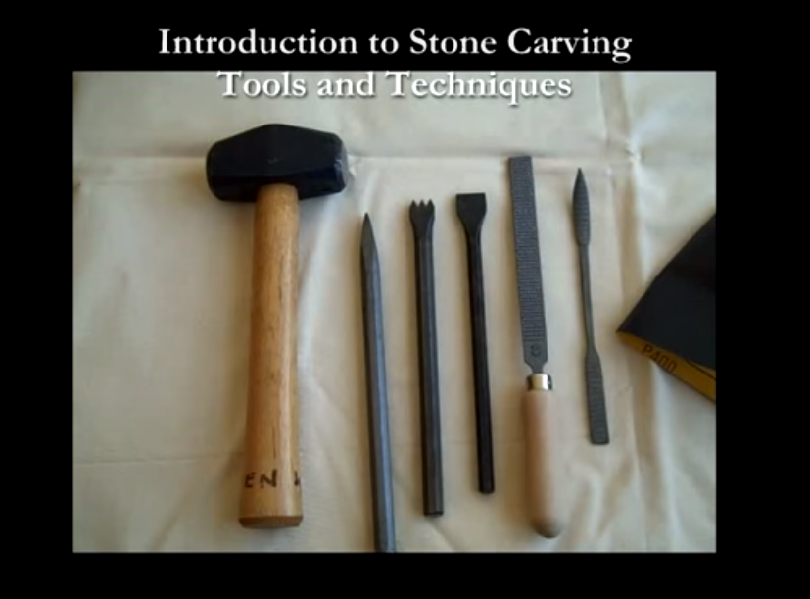
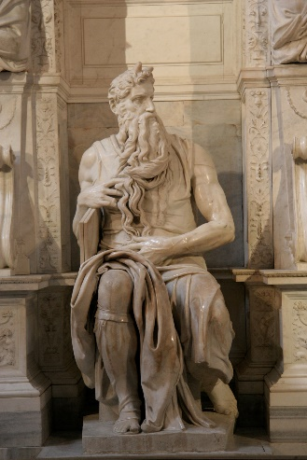
Group Talk
How were the prehistoric cave people similar to stone carving artists today? How were they different?
What are some of the difficulties that might result from picking the wrong kind of stone for a sculpture?
Even with modern tools available to them, some artists choose to only use the traditional hammer and chisel, why would they do this when easier methods are available?
Here is a pretty interesting video exploring
how to use each tool in traditional carving.
https://upload.wikimedia.org/wikipedia/commons/thumb/7/70/'Moses'_by_Michelangelo_JBU160.jpg/240px-'Moses'_by_Michelangelo_JBU160.jpg
Notes:
Video - https://www.youtube.com/watch?v=FBCHa4t8eYk
Statue - https://upload.wikimedia.org/wikipedia/commons/thumb/7/70/'Moses'_by_Michelangelo_JBU160.jpg/240px-'Moses'_by_Michelangelo_JBU160.jpg
Marble - http://www.knoll.com/nkdc/images/inspiration/marble/INSP-marble-hero-stone.jpg

Slide 7
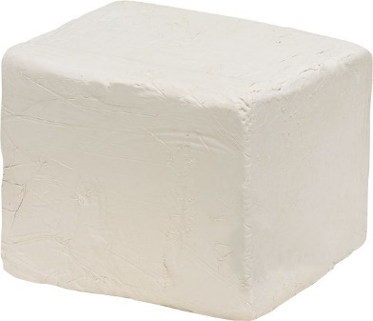
hands-on with sculpting
Trying to create a figure out of a large chunk of stone may sound easy, but trying to do so yourself may prove a bit more challenging. Gaining a better understanding of how much time, skill, and effort previous artists had to put into their work helps convey how passionate and devoted they were to creating.
Group Talk
What is your hypothesis about what will happen when mixing your own pigments? Will they work? Will the pigment stick to the paper?
What types of natural materials could we use to create pigments?
What is a binder? Any idea why it might be important in paint?
Take a solid block of clay material about the size of a brick and place it on a hard surface.
Pick some sort of figure you want to model the clay into and set it where you can see it.
Use clay sculpting tools to ‘chisel” away at the block of clay to make it look like the figure chosen.
Any clay that is taken off cannot be put back on, and only the tools can be used to remove clay. Good luck!
1
Notes:
Clay - https://cdn-glaserceramics.netdna-ssl.com/image/cache/data/clay/clay_block_porcelain-565x565.jpg

Slide 8

Renaissance Art and notable artists
http://userscontent2.emaze.com/images/cea9f073-2d58-4d4e-b378-58f54906b24a/635386928081356682_tumblrmcf8q8sQP71rq89bvo1500.jpg
Notes:
Artists - http://userscontent2.emaze.com/images/cea9f073-2d58-4d4e-b378-58f54906b24a/635386928081356682_tumblrmcf8q8sQP71rq89bvo1500.jpg

Slide 9
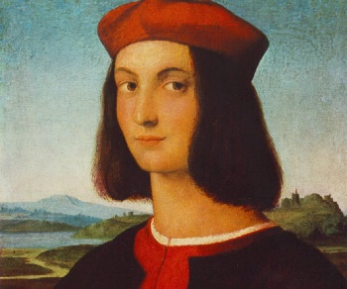
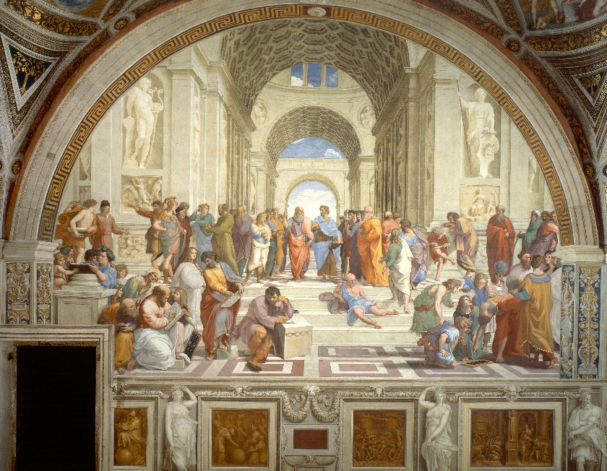
Raphael
Alongside da Vinci and Michelangelo, Raphael is known as the third of the great master artists of Renaissance Italy. He was born in 1483, and his works were extremely influential even during his lifetime. During his short life, he produced a huge number of works including paintings, frescoes, prints, and more.
One of his most famous works is The School of Athens. It is a classic example of Renaissance art and culture in general, as the culture of the period frequently referenced Roman and Greek antiquity.
On April 6, 1520, Raphael’s 37th birthday, he died suddenly and unexpectedly of mysterious causes in Rome, Italy. He had been working on his largest painting on canvas, The Transfiguration (commissioned in 1517), at the time of his death. When his funeral mass was held at the Vatican, Raphael's unfinished Transfiguration was placed on his coffin stand.
Following his death, Raphael's movement toward Mannerism influenced painting styles in Italy’s advancing Baroque period. Celebrated for the balanced and harmonious compositions of his "Madonnas," portraits, frescoes and architecture, Raphael continues to be widely regarded as the leading artistic figure of Italian High Renaissance classicism.
http://www.thefamouspeople.com/profiles/images/raphael-3.jpg
https://www.brainscape.com/blog/2015/06/most-important-renaissance-artists/
http://www.biography.com/people/raphael-41051#architecture
Group Talk
https://upload.wikimedia.org/wikipedia/commons/9/94/Sanzio_01.jpg
Raphael featured daily life in his paintings. How can artists turn the ordinary into the extraordinary? Specific scenes, details, people, places, history.
The works of Michelangelo influenced Raphael's style. What similarities can you see between the two artists? Focus on the depiction of the human body, realism, and balance.
Notes:
Website for Bio - https://www.brainscape.com/blog/2015/06/most-important-renaissance-artists/
Raphael - http://www.thefamouspeople.com/profiles/images/raphael-3.jpg
School of Athens - https://upload.wikimedia.org/wikipedia/commons/9/94/Sanzio_01.jpg
Bio 2 - http://www.biography.com/people/raphael-41051#architecture

Slide 10
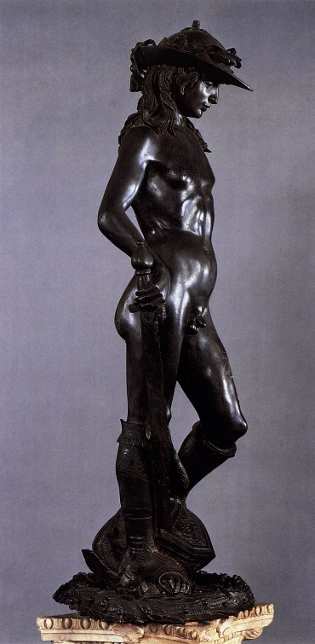
Donatello
Born in Florence, Donato di Niccolò di Betto Bardi, or Donatello, hailed from the period now known as the early Renaissance and preceded the others mentioned here. Donatello worked mainly as a sculptor, and the realism he was able to create marked a stark break from the stiff, un-lifelike statuary common in the Middle Ages.
Did you know that Donatello, like Michelangelo, made a famous sculpture of David? Unlike Michelangelo’s giant marble piece, Donatello made his out of bronze. He also attempted a stone version earlier on in his career, however it was not nearly as masterful as the one Michelangelo later made.
Donatello worked closely with the Medici family, the rulers of Florence. By this time, Donatello was gaining a reputation for creating imposing, larger-than-life figures using innovative techniques and extraordinary skills. His style incorporated the new science of perspective, which allowed the sculptor to create figures that occupied measurable space. Before this time, European sculptors used a flat background upon which figures were placed. Donatello also drew heavily from reality for inspiration in his sculptures, accurately showing suffering, joy and sorrow in his figures’ faces and body positions.
http://www.biography.com/people/donatello-21032601#unique-style
https://www.brainscape.com/blog/2015/06/most-important-renaissance-artists/
Group Talk
http://www.wga.hu/art/d/donatell/1_early/david/2david2.jpg
What properties of the biblical figure David made him such a popular sculpture for Renaissance artists to recreate?
Like Michelangelo, Donatello also worked with the Medici family. Why was it so important for artists to be close to such powerful families?
Notes:
Bio - https://www.brainscape.com/blog/2015/06/most-important-renaissance-artists/
Bio 2 - http://www.biography.com/people/donatello-21032601#unique-style
David - http://www.wga.hu/art/d/donatell/1_early/david/2david2.jpg

Slide 11
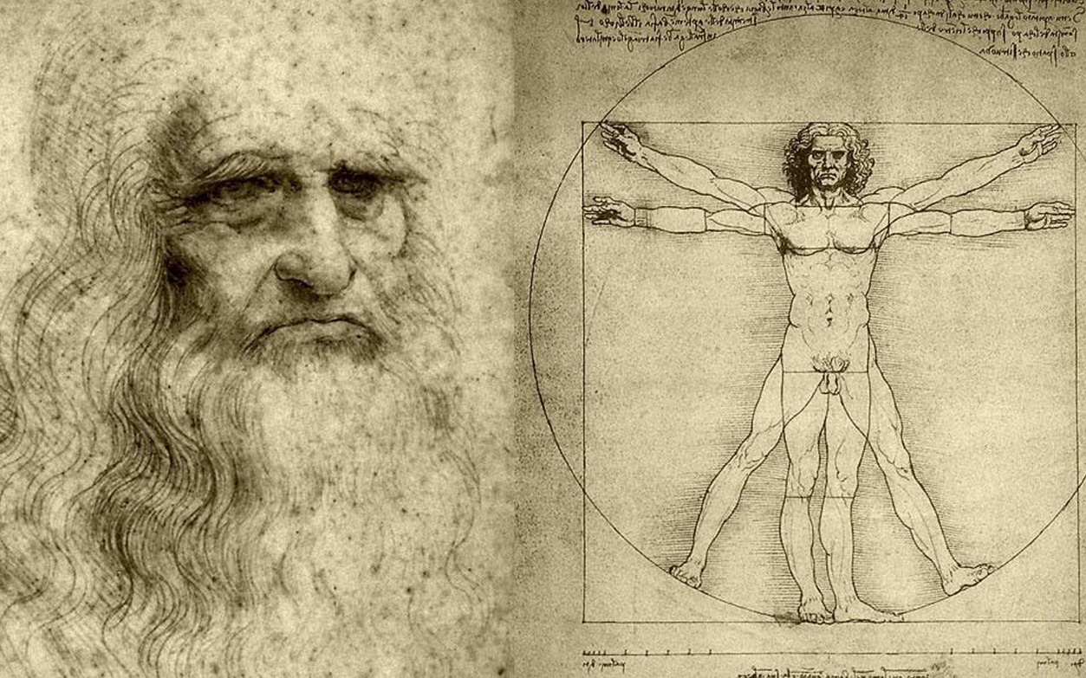
  Leonardo da vinci
Born on April 15, 1452, in Vinci, Italy, Leonardo da Vinci was the epitome of a “Renaissance man.” Possessor of a curious mind and keen intellect, da Vinci studied the laws of science and nature, which greatly informed his work as a painter, sculptor, architect, inventor, military engineer and draftsman. His ideas and body of work—which includes "Virgin of the Rocks," "The Last Supper" and "Mona Lisa"—have influenced countless artists and made da Vinci a leading light of the Italian Renaissance.
Leonardo thought sight was humankind’s most important sense and eyes the most important organ. He stressed the importance of saper vedere, “knowing how to see.” He believed in the accumulation of direct knowledge and facts through observation.
“A good painter has two chief objects to paint—man and the intention of his soul,” da Vinci wrote. “The former is easy, the latter hard, for it must be expressed by gestures and the movement of the limbs.” To more accurately depict those gestures and movements, da Vinci began to seriously study anatomy and dissect human and animal bodies during the 1480s. His drawings of a fetus in utero, the heart and vascular system, sex organs and other bone and muscular structures are some of the first on human record.
In addition to his anatomical investigations, da Vinci studied botany, geology, zoology, hydraulics, aeronautics and physics. He sketched his observations on loose sheets of papers and pads that he tucked inside his belt. He placed the papers in notebooks and arranged them around four broad themes—painting, architecture, mechanics and human anatomy. He filled dozens of notebooks with finely drawn illustrations and scientific observations. His ideas were mainly theoretical explanations, laid out in exacting detail, but they were rarely experimental.
https://i.ytimg.com/vi/f5x3MaZ6fqQ/maxresdefault.jpg
“A good painter has two chief objects to paint—man and the intention of his soul.”
http://www.biography.com/people/leonardo-da-vinci-40396
Notes:
Picture - https://i.ytimg.com/vi/f5x3MaZ6fqQ/maxresdefault.jpg
Bio - http://www.biography.com/people/leonardo-da-vinci-40396

Slide 12
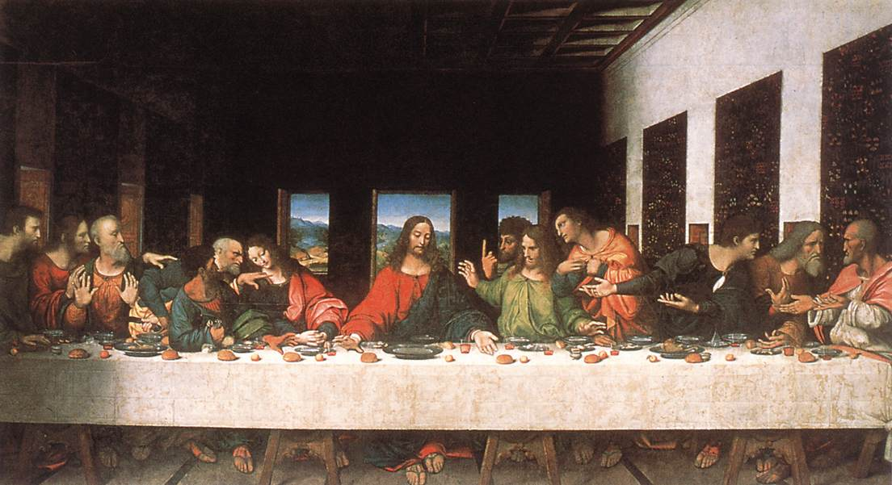
  Leonardo da vinci
Around 1495, Ludovico commissioned da Vinci to paint “The Last Supper” on the back wall of the dining hall inside the monastery of Milan’s Santa Maria delle Grazie. The masterpiece, which took approximately three years to complete, captures the drama of the moment when Jesus informs the Twelve Apostles gathered for Passover dinner that one of them would soon betray him. The range of facial expressions and the body language of the figures around the table bring the masterful composition to life. The decision by da Vinci to paint with tempera and oil on dried plaster instead of painting a fresco on fresh plaster led to the quick deterioration and flaking of “The Last Supper.” Although an improper restoration caused further damage to the mural, it has now been stabilized using modern conservation techniques.
http://www.biography.com/people/leonardo-da-vinci-40396
https://upload.wikimedia.org/wikipedia/commons/2/23/Leonardo_da_Vinci_-_Last_Supper_(copy)_-_WGA12732.jpg
Group Talk
Most of these artist have been remembered for their paintings rather than their sculptures. What reasons might there be for this?
Leonardo and Michelangelo both focused on the human anatomy extensively to do their art. What benefits could this have had? What do modern artists do to prepare themselves for their art?
Notes:
Bio - http://www.biography.com/people/leonardo-da-vinci-40396
Last Supper - https://upload.wikimedia.org/wikipedia/commons/2/23/Leonardo_da_Vinci_-_Last_Supper_(copy)_-_WGA12732.jpg

Slide 13
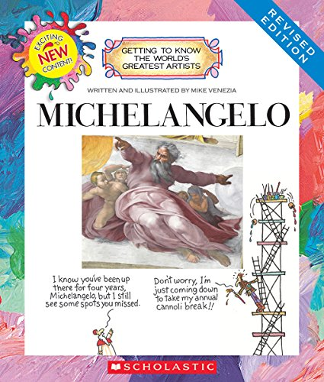
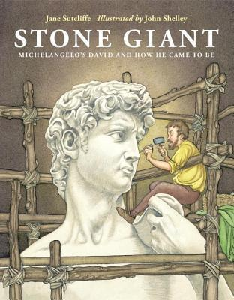
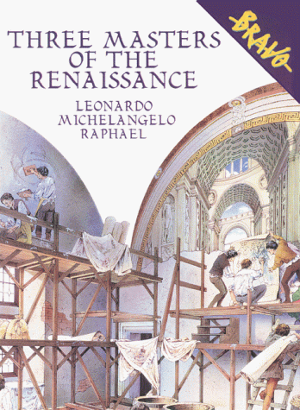
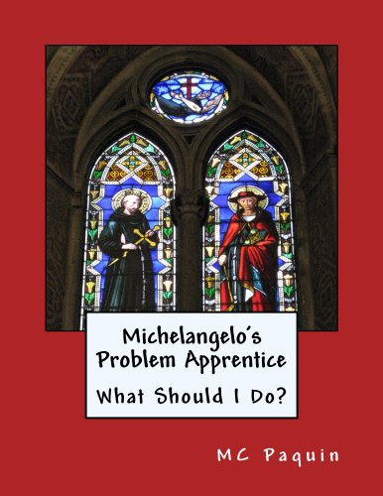
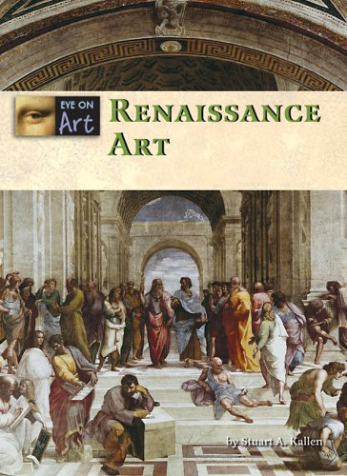
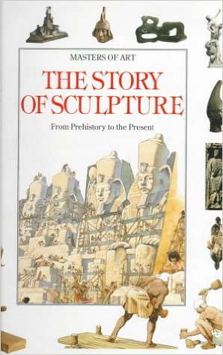
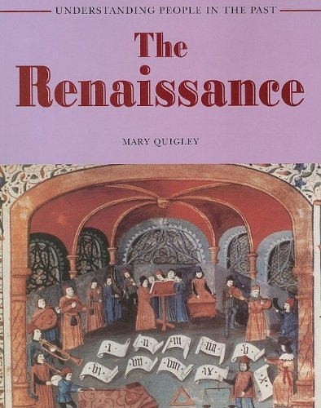
Books for Further reading
Michelangelo Getting to Know the World's Greatest Artist (Mike Venezia)
Stone Giant: Michelangelo’s David and How He Came to Be (Jane Sutcliffe)
The Story of Sculpture : From prehistory to the present (Francesca Romei)
The Renaissance Understanding People in the Past (Mary Quigley)
Three Masters of the Renaissance: Leonardo, Michelangelo, Raphael (Claudio Merlo, et al)
Michelangelo's Problem Apprentice: What Should I Do? (MC Paquin)
Renaissance Art (Stuart Kallen)

Slide 14

educational standards
Within every episode we strive to meet every content standard within the National Core Arts Standards. Please be sure to include and reference these standards when preparing and documenting your lessons. For additional, and more in-depth information, you can reference this site.
Associated Anchor Standards
Creating
#VA:Cr1.1
Anchor Standard: Generate and conceptualize artistic ideas and work.
Enduring Understanding: Creativity and innovative thinking are essential life skills that can be developed.
Essential Question: What conditions, attitudes, and behaviors support creativity and innovative thinking? What factors prevent or encourage people to take creative risks? How does collaboration expand the creative process?
#VA:Cr1.2
Anchor Standard: Generate and conceptualize artistic ideas and work.
Enduring Understanding: Artists and designers shape artistic investigations, following or breaking with traditions in pursuit of creative art-making goals.
Essential Question: How does knowing the contexts histories, & traditions of art forms help us create works of art & design? Why do artists follow or break from established traditions? How do artists determine what resources are needed to formulate artistic investigations.
#VA:Cr2.1
Anchor Standard: Organize and develop artistic ideas and work.
Enduring Understanding: Artists and designers experiment with forms, structures, materials, concepts, media, and art-making approaches.
Essential Question: How do artists work? How do artists and designers determine whether a particular direction in their work is effective? How do artists and designers learn from trial and error?

Slide 15
educational standards
Creating
#VA:Cr2.3
Anchor Standard: Organize and develop artistic ideas and work.
Enduring Understanding: People create and interact with objects, places, and design that define, shape, enhance, and empower their lives.
Essential Question: How do objects, places, and design shape lives and communities? How do artists and designers determine goals for designing or redesigning objects, places, or systems? How do artists and designers create works of art or design that effectively communicate
#VA:Cr3.1
Anchor Standard: Refine and complete artistic work.
Enduring Understanding: Artist and designers develop excellence through practice and constructive critique, reflecting on, revising, and refining work over time.
Essential Question: What role does persistence play in revising, refining, and developing work? How do artists grow and become accomplished in art forms? How does collaboratively reflecting on a work help us experience it more completely?

Slide 16
educational standards
Responding
#VA:Re7.1
Anchor Standard: Perceive and analyze artistic work.
Enduring Understanding: Individual aesthetic and empathetic awareness developed through engagement with art can lead to understanding and appreciation of self, others, the natural world, and constructed environments.
Essential Question: How do life experiences influence the way you relate to art? How does learning about art impact how we perceive the world? What can we learn from our responses to art?
#VA:Re7.2
Anchor Standard: Perceive and analyze artistic work.
Enduring Understanding: Visual imagery influences understanding of and responses to the world.
Essential Question: What is an image? Where and how do we encounter images in our world? How do images influence our views of the world?
#VA:Re8.1
Anchor Standard: Interpret intent and meaning in artistic work.
Enduring Understanding: People gain insights into meanings of artworks by engaging in the process of art criticism.
Essential Question: What is the value of engaging in the process of art criticism? How can the viewer "read" a work of art as text? How does knowing and using visual art vocabularies help us understand and interpret works of art?
#VA:Re7.2
Anchor Standard: Perceive and analyze artistic work.
Enduring Understanding: Visual imagery influences understanding of and responses to the world.
Essential Question: What is an image? Where and how do we encounter images in our world? How do images influence our views of the world?

Slide 17
educational standards
Connecting
#VA:Cn11.1
Anchor Standard: Relate artistic ideas and works with societal, cultural, and historical context to deepen understanding.
Enduring Understanding: People develop ideas and understandings of society, culture, and history through their interactions with and analysis of art.
Essential Question: How does art help us understand the lives of people of different times, places, and cultures? How is art used to impact the views of a society? How does art preserve aspects of life?
#VA:Re8.1
Anchor Standard: Interpret intent and meaning in artistic work.
Enduring Understanding: People gain insights into meanings of artworks by engaging in the process of art criticism.
Essential Question: What is the value of engaging in the process of art criticism? How can the viewer "read" a work of art as text? How does knowing and using visual art vocabularies help us understand and interpret works of art?
copyright 2016 Artrageous with Nate, LLC.

